Slide 1

Knowledge Area Covered in the Board of Governor’s Exam:
Business
Becoming Board Certified in Healthcare Management and a Fellow of the American College of Healthcare Executives

Slide 2
Business
Introduction
Business is the knowledge that pertains to specific areas/
concepts of the organization (e.g., marketing, business
planning, strategic planning).
Notes:
Search ACHE.org under publications, and you will find 1267 results which includes 230 articles and 26 books. Endless You Tube videos, TED talks, education orgs websites, and other resources for learning this subject.

Slide 3
Business
18 questions (9%) from this specific knowledge area will be asked on the
Board of Governor’s Exam related to the following:
Knowledge of basic statistical analysis
Knowledge of strategic planning principles
Knowledge of basic business contracts (e.g., legal and financial implications)
Knowledge of marketing principles and tools (e.g., market analysis, market research, sales, advertising)
Knowledge of techniques for business plan development and implementation
Knowledge of principles of public and community relations
Knowledge of the functions of organizational policies and procedures
Notes:
Knowledge of 7 areas that support the operations of health care. We will talk about six of them- skipping statistical analysis which is a basic and essential business tool which undergirds all the other knowledge areas
Search for many on-line resources- good starting place for a novice is Statistical Analysis with Excel For Dummies (For Dummies (Computer/Tech)) 5th Edition 2022

Slide 4
Business
Learning Objectives
Strategic Planning Principles
Basic Business Contracts
Business Plan Development and Implementation
Marketing Principles and Tools
Public and Community Relations
Organizational Policies and Procedures
Notes:
Breaking it down to the categories of business.

Slide 5
Business
Learning Objective:
1. Strategic Planning Principles (e.g., strategic
planning is now viewed more appropriately as “strategic management” in that planning must be integrated with other management functions (i.e., organizing, directing, controlling, staffing and decision making); current strategic planning processes usually consist of assessment, planning, implementation, and evaluation and continuous improvement)
Notes:
How many of you are involved in strategic planning in your organizations? Can you describe what that experience is like for the group?

Slide 6
Business
1. Strategic Planning Principles continued……
– Mission
– Objectives
– Assessment/Situation Analysis
– Planning/Strategy Formulation
– Implementation
– Evaluation/Control
– Continuous Improvement
Notes:
Think of the seven steps like a flow chart where the steps are necessarily sequential. Need to include stakeholders in the early steps to ensure alignment within organization leadership and staff and others and to verify have buy in from important areas. Who are your stakeholders? Consider who can help contribute to the process, who can serve as champions? Who can serve as your devil’s advocate for balance?

Slide 7

Mission
  Mission Statement: our fundamental
  purpose/reason for existence. It should be
  constructed so as to guide
  organizational behavior
  Sense of purpose to employees
  Convey an image to customers
  A key component is how our mission responds to the healthcare needs of the community
Objectives
  Concrete goals; e.g. earnings growth target
    Short and long term goals should be consistent with the philosophy and mission of the institution
  Challenging but achievable
  Measurable
Notes:
By a show of hands, how many of you can quote the mission statement for your organization? What about your vision statement? If you don’t know what it is, how do you know that you are aligned with it in the decisions that you make at your level? The mission statement needs to be constructed in such a way that it speaks to every level of the organization. If it does not, it is just words on a page.
Some short and some longer.
Mayo Clinic mission: Inspiring hope and promoting health through integrated clinical practice, education and research.
Houston Methodist: To provide high quality, cost-effective health care that delivers the best value to the people we serve in a spiritual environment of caring in association with internationally recognized teaching and research.
MD Anderson: The mission of The University of Texas MD Anderson Cancer Center is to eliminate cancer in Texas, the nation, and the world through outstanding programs that integrate patient care, research and prevention, and through education for undergraduate and graduate students, trainees, professionals, employees and the public.
Objectives- Objectives are the goals that your organization will use to provide direction to the implementation of the mission and to outline an expected cadence for that mission’s implementation.
Acheivable goals are the key to success. Everything that sounds good is not a good idea. How many of you can attest that you have witnessed organizations chasing their tales for years trying to achieve something that they should have recognized was not within their ability to achieve and likely was not within their scope. That doesn’t mean that we should abandon innovation but that innovatation should be strategic and in alignment with our vision. Example: Health equity.
Ask: How does your mission reflect community healthcare needs?

Slide 8

Business
Strategic Planning Principles continued……
Assessment/Situation Analysis
    (How we get there from here)
    Scan environmental opportunities
      Macro
      - Political, economic, social, technological
      Micro
      - Barriers to entry, customers, suppliers,
      substitute products, competition
Notes:
Need to know where you are before you decide where to go and how you will get there. Also provides the basis for reality checks.
Macro - Regulatory- healthcare is one of the most if not the most regulated industry. Local, state and federal political climate WRT healthcare. Various levels of legal/governmental certifications, permits, requirements must be met.
Micro - Supply chain and the cost of goods also may important to consider.

Slide 9
Business
Strategic Planning Principles continued…
Assessment/Situation Analysis
    (How we get there from here)
    Assess capabilities and limitations
    – SWOT analysis (Strengths, Opportunities,
    Weaknesses, Threats)
    For a healthcare organization, success is measured by how well it adapts to external and internal environments
Notes:
The SWOT analysis is a framework that one can use to objectively evaluate an organization’s competitive position in the market. The more we access our stakeholder’s feedback in this process, the more likely we are to understand how to move the organization forward in the market. Transparency is paramount in this process.
Adapting to external and internal: this became clearly evident with the onset of the COVID pandemic. Currently portability of the workforce and remote work, manpower are primary. Supply chain issues involving pharmaceuticals, supplies, equipment, etc. Keeping up with publications like Becker’s Report and McKinsey and others is critical to healthy assessment and SWOT. We are seeing enormous fluidity in the healthcare business and swings in successes and failures. Another analysis tool that builds more on the components of the SWOT analysis is the PESTEL analysis. PESTEL stands for political, economic, social, technological, environmental and legal. If you are interested in learning more about this analysis and how to incorporate it into your strategic plan, you can Google it like I did. ☺
Ask: Would someone be willing to share with the group any internal or external factors have recently impacted your strategic decisions?

Slide 10
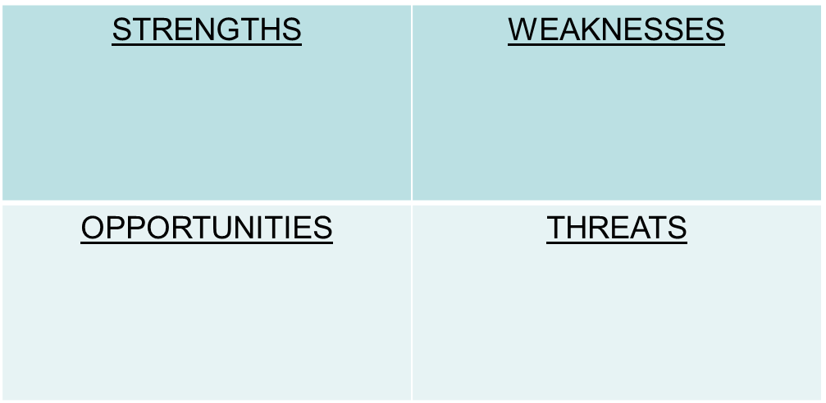
Business
Strategic Planning Principles continued…
Notes:
Strengths describe what an organization excels at and what separates it from the competition: a strong brand, loyal customer base, a strong balance sheet, unique technology, etc.
Weaknesses are areas where the business needs to improve to remain competitive: a weak brand, higher-than-average turnover, high levels of debt, an inadequate supply chain, or lack of capital.
Opportunities refer to favorable external factors that could give an organization a competitive advantage. Can any of you think of an opportunity that might exist in the healthcare market? What about the approach that Amazon and CFS (for example) are taking to capture some of our customers with these small clinics and other unique approaches to healthcare delivery?
Threats can be factors that have the potential to harm an organization. They can include things like rising costs for materials, increasing competition, tight labor supply, etc. Can you think of some others?

Slide 11
Business
Strategic Planning Principles continued…
Internal Analysis
    Organizational culture and image
    Organizational structure
    Key staff
    Access to natural resources
    Position on the experience curve
    Operational efficiency
Notes:
We are going to look at one-half of the analysis that each organization needs to take into consideration. We will not cover external analysis in this course but it is equally important to the success of your strategic planning.
Internal Analysis:
What do you already have to work with?
How are you viewed by employees, by the community?
Do you have Experts or expertise already in your company?
Where are you strong?
What is missing or weak?

Slide 12
Business
Strategic Planning Principles continued…
Internal Analysis continued…….
    Operational capacity
    Brand awareness
    Market share
    Financial resources
    Exclusive contracts
    Patents and trade secrets
Notes:
More areas to look at.
Need to analyze all facets of organization and environment with a critical eye.
Business analytics are important here.
Ask: Which strategy aligns best with your current market position?

Slide 13
Business
Strategic Planning Principles continued…
Planning/Strategy Formulation
  Two generic strategies
    Cost leadership
    Differentiation
  Expressed in high-level conceptual terms and priorities
Notes:
There are many strategies that can be utilized in the formulation of your strategic plan. For the purposes of the exam, we will focus on the two that ACHE recommend
"Cost Leadership" (no frills, low cost provider, economy of scale) AND
“Differentiation" (creating uniquely desirable products and services that set your organization apart from the competition)
Which do you aim to be?

Slide 14

Strategic Planning Principles continued…
Implementation
  Identify required resources and establish necessary organizational changes
  Translate and communicate into detailed policies understood at the functional levels of the organization
  Assure that goals are applied uniformly at all organizational levels
  Functional Areas
    Marketing, R&D, Procurement, Production,
    Human Resources, Information Systems
Notes:
Focus groups and representation from all areas and including various levels of the organization at this step.
You only know what is in your head based on your experience and knowledge.
Good communication essential to this step to ensure successful implementation.
Ideally everyone must be “in” for optimal chances of success.
Engagement of all stakeholders is key.
The bigger the initiative, the broader inclusion needed.

Slide 15

Business
Strategic Planning Principles continued…
Evaluation/Control
    Set standards of performance
    Measure performance
    Act on actual measures
    Develop control systems for measurement
Notes:
Evaluation and control help us know we are performing in alignment with the established and agreed strategies, and the plan is appropriate and succeeding.
May need to update the measures over time as things move along. Some measures may become out of date or irrelevant, or new ones may be appropriate to the current circumstances.
As an example- you may implement a new patient scheduling workflow for patient self-scheduling based on the available technology at the time. The way you measure outcomes may have originally been anchored in patient preference and providers begin to complain the cancelation rates/no show rates are increasing.
Measure, measure, measure to prove the plan is working or identify what needs adjustment.

Slide 16
Business
Strategic Planning Principles continued…
Continuous Improvement
    Be responsive to a rapidly changing environment
    Listen to those closest to the day-to-day operations
    Be prepared to modify long-term forecasts
Notes:
The best ideas come from those who are on the front lines. If you do not know what they are thinking, you are setting yourself up for failure.
Critically important to celebrate victories and reward progress.
Be prepared to be wrong and change.
Keep an open mind.
Opportunity to learn and improve.

Slide 17


Business
Strategic Planning Principles continued…
Continuous Improvement continued….
    Observe and measure changes in any one of the components
    Accept that strategies must be adaptable to unanticipated external/internal developments
    Communicate changes in course to all concerned
Notes:
Continuous improvement prevents strategic plans from becoming outdated and helps ensure relevance.
Expect the healthcare landscape to change- it’s like the weather -it always does.
Plan for the worst and hope for the best.
Ensure that ALL changes to the plan or implementation are communicated broadly. We have already covered this but you cannot over communicate, especially when it related to changes needed to the strategic direction. Don’t assume that because everyone in the Boardroom knows what you are thinking, that the front-line has access to that same information.
Ask: What are some ways that your organization ensures effective communication at all levels?

Slide 18
Business
Strategic Planning Knowledge Quiz:
All of the following are essential components of strategic planning except:
a. The corporate mission statement.
b. Timetables for activity completion.
c. Competitive analysis.
d. Assessment of the external environment.

Slide 19
Business
Strategic Planning Knowledge Quiz:
All of the following are essential components of strategic planning except:
a. The corporate mission statement.
b. Timetables for activity completion.
c. Competitive analysis.
d. Assessment of the external environment.
Notes:
B. Timetables for completion- these are established as milestones to measure tactical progress.

Slide 20
Business
Strategic Planning Knowledge Quiz:
What is the first stage in the strategic planning process?
a. Board retreat
b. Situation analysis
c. Mission statement development
d. Action planning

Slide 21
Business
Strategic Planning Knowledge Quiz:
What is the first stage in the strategic planning process?
a. Board retreat
b. Situation analysis
c. Mission statement development
d. Action planning
Notes:
B. Situation analysis- like Google Maps you can’t get or provide directions unless you know where you start out.

Slide 22
Business
Strategic Planning Knowledge Quiz:
Short-range planning is enhanced if a strategic plan has been adopted because:
a. Potential program can be eliminated easily if not part of the strategic plan.
b. Use of space has already been determined.
c. A frame of reference is already in place.
d. Operational problems can be quickly resolved.

Slide 23
Business
Strategic Planning Knowledge Quiz:
Short-range planning is enhanced if a strategic plan has been adopted because:
a. Potential program can be eliminated easily if not part of the strategic plan.
b. Use of space has already been determined.
c. A frame of reference is already in place.
d. Operational problems can be quickly resolved.
Notes:
C. A frame of reference is already in place. Having a solid grasp on the current realities significantly improves short (and long) term planning.

Slide 24
Business
Learning Objective:
Basic Business Contracts (e.g., a contract that clearly delineates performance requirements; four elements of a valid contract include (1) an agreement is reached after an offer is accepted, (2) there is consideration or something of value in the agreement, (3) the agreement is reached by parties who have the legal capacity to contract and (4) the contract’s objective /purpose is lawful)
Notes:
The purpose of a contract is to define what parties who otherwise have no obligation to each other will do.
Four components (see slide)
All four components must be in place to have a formal contract that has “teeth”

Slide 25

Business
2. Basic Business Contracts continued…
    Definition
    Elements

Slide 26
Business
2. Basic Business Contracts continued……
Definition
    – A contract is a legally enforceable agreement or promise between two or more parties, enforceable in courts
Notes:
Let’s be honest, if you need a definition of what a business contract is, you probably are not ready to take this exam. However, these are the slides provided by the all-knowing ACHE so here we go!
Examples of contracts include employment contracts, property leases, construction contracts, managed care (insurance) provider contracts

Slide 27

Business
2. Basic Business Contracts continued…
Elements
    – Offer/Acceptance
    – Consideration
    – Legal Capacity
    – Lawful
Notes:
Four elements- details on next 4 slides.

Slide 28
Business
2. Basic Business Contracts continued…
Elements continued….
Offer
● Offer – a promise to perform an act based on a return
promise of performance by another party
● Recognized by a specific proposal communicated to
another party
● Once made, offering party is bound to its terms if the
other party accepts
Notes:
How the OFFER works- one party promises something based on what the other party will do.
This is captured in a specific proposal.
Once the offer is made and the other party accepts, it is formally in force.
Example- employment contract: 1) employer offers compensation for work 2) offer provided to a qualified prospective employee 3) once offered the CONTRACT is valid when accepted by the prospective employee.

Slide 29
Business
2. Basic Business Contracts continued……
Elements continued….
Acceptance
● Assent to the terms of the offer made by the offeree in
the manner invited or required by the offeror
● No contract is formed until the offeree accepts the offer
● Offeror is free to revoke the contract at any time before
acceptance of the offer
● Once the offeror terminates the offer, the offeree no
longer has the legal power to accept the offer and form a
contract
Notes:
Once offeree accepts, it is in force.
Offeror can withdraw as long as it has not been accepted. NEGOTIATION between the parties and lawyers to get details confirmed occurs PRIOR to the offer.
In simple terms via example: Construction company offers contract to for a new building for a Hospital system. Hospital agrees to the terms (after negotiation of specifics including what will be constructed, timelines, milestones, how much compensation the hospital will provide, etc. ). Contract is formed when Hospital accepts the offer. Construction company is free to withdraw the contract up until the Hospital accepts it.

Slide 30
Business
2. Basic Business Contracts continued……
Elements continued….
Consideration
● What one party to a contract will get from the
other party in return for performing contractual
obligations – “mutual considerations”
● Doing something that you were not previously
bound to do outside of the agreement
Notes:
Example: Construction company will build a building. Hospital will provide compensation.

Slide 31
Business
2. Basic Business Contracts continued……
Elements continued….
Legal Capacity
● Generally, anyone over the age of 18 who is mentally
competent (has the mental capacity to understand the
nature and consequences of the transaction)
● Must not be signed by a person exceeding his/her
authority
Notes:
Organizations have policies about who has what level of authority. May be based on job title, dollar amount, or other structures put in place to protect the organization.

Slide 32
Business
Basic Business Contracts Knowledge Quiz:
In negotiating a contract for an information system, healthcare organizations should:
a. Form a negotiating team and utilize legal counsel.
b. Use the standard contract provided by the system vendor.
c. Employ a consultant from among a list provided by the vendor.
d. Use a cost-plus contract to maximize flexibility in system design.

Slide 33
Business
Basic Business Contracts Knowledge Quiz:
In negotiating a contract for an information system, healthcare organizations should:
a. Form a negotiating team and utilize legal counsel.
b. Use the standard contract provided by the system vendor.
c. Employ a consultant from among a list provided by the vendor.
d. Use a cost-plus contract to maximize flexibility in system design.
Notes:
A. Form a negotiating team and utilize legal counsel

Slide 34
Business
Learning Objective:
Business Plan Development and Implementation
(e.g., a business plan serves as a vital communications
and planning tool to channel efforts for a particular
project or initiative; business planning process includes
four steps: (1) assess your current situation, (2) decide
what you want to accomplish by drafting your objectives,
(3) ensure all have input into the process and (4) discuss
whether your business planning process is meeting
objectives)
Notes:
Strategic plan is the “what” and business plan is the “how”
Serves as THE primary communication and planning tool for an initiative,
Like strategic planning, business planning includes sequential steps – four of them (see slide)

Slide 35
Business
Learning Objective:
Business Plan Development and
Implementation continued……
  An integrated set of strategies to achieve the mission
  Develop each strategy as a multiyear plan for a set of process with specific objectives, overseen by a senior management team.
    Contribution of the strategy to the mission and stakeholder needs
    Specific, quantitative goals
    Identify resources
    Establish accountability
Notes:
Depending on your role, you may or may not have as much exposure throughout your career to some of these areas of business as others. For instance, some of you may not ever be invited to the Board Room to participate in strategic planning. You may or may not have a lot of exposure to how contracts are structured and executed in your organization. However, there is a large chance that you will be involved at some point in the development of a Business Plan. These business plans can be as expansive as new Service Line that will change how you deliver care at your organization or the development of a smaller operational department. A business plan is an integrated set of strategies combined into a model that will standup an entity designed to further the mission of your institution. See Slide

Slide 36
Business
Learning Objective:
Business Plan Development and
Implementation continued……
  Develop each strategy as a multiyear plan for a set of process with specific objectives, overseen by a senior management team (cont.)
    Timetable and interim checkpoints
    Evaluation of risks and contingency plans
  Appropriate application of a business plan is Service Line Development: coordinated programs of care for groups of diseases that require similar knowledge, treatment approaches and resources
Notes:
The plan should be developed by key executives and heads of the operating departments with input from all stakeholders.

Slide 37
Business
Learning Objective:
Business Plan Development and
Implementation continued……
  Service Line Development: coordinated programs of care for groups of diseases that require similar knowledge, treatment approaches and resources
    Clinical support services (ER, OR, Lab, etc)
    Accountability centers responsible for specific parts of the strategy, creating quantitative goals, resource needs and timetables
  Keeping an eye on identified metrics; refine as needed
Notes:
Build a stepwise program to ensure milestones will provide appropriate resources for accommodating growth, pivot points, and timelines.
Watch metrics closely and continue to refine as needed
Ask: What service lines have you recently been involved with expanding or refining?

Slide 38
Business
Learning Objective:
Business Plan Development and
Implementation continued……
  Promote continuous improvement
    Measurement and Benchmarking
    Customer Orientation
    Worker Empowerment
Notes:
Examples: Master Facilities Site Plan AND Adolescent and Young Adult Oncology Program business plan.
The Master Facilities Site Plan for an organization outlines future facility needs (renovation or new construction) necessary to meet strategic and operational needs.
Business plans ties together the care that spans pediatrics and adult oncology, medical specialties, surgery, DI, integrative medicine, etc.
Critical that the planned development fits in the mission and overall strategic plan.

Slide 39
Business
Business Plan Knowledge Quiz:
Before submission of the annual business plan to the governing authority, the plan should be developed by:
a. Recommendations from the finance committee, on the basis of its estimate of income for the budget year.
b. The heads of the profit centers, considering each center's anticipated revenues and expenses, with the CEO collating.
c. Key executives, after receiving recommendations from the head of operating divisions.
d. The heads of the operating divisions, with the CEO collating

Slide 40
Business
Business Plan Knowledge Quiz:
Before submission of the annual business plan to the governing authority, the plan should be developed by:
a. Recommendations from the finance committee, on the basis of its estimate of income for the budget year.
b. The heads of the profit centers, considering each center's anticipated revenues and expenses, with the CEO collating.
c. Key executives, after receiving recommendations from the head of operating divisions.
d. The heads of the operating divisions, with the CEO collating
Notes:
C. Key executives after receiving recommendations from the head of operating divisions. May include Finance Committee stakeholders but to ensure success, needs to be a broader team.
The plan is solidified by agreement from all impacted by it.

Slide 41
Business
Business Plan Knowledge Quiz:
The master site plan (or master facility plan) for a healthcare organization:
Describes future facility needs (renovation or new construction) necessary to meet strategic and operational needs.
Provides detailed design documents for all construction programs along with specific costs for each project.
Must be prepared by an outside planning or architectural firm to ensure sufficient objectivity.
Is necessary to ensure the organization complies with certificates of need and other regulatory requirements.

Slide 42
Business
Business Plan Knowledge Quiz:
The master site plan (or master facility plan) for a healthcare organization:
Describes future facility needs (renovation or new construction) necessary to meet strategic and operational needs.
Provides detailed design documents for all construction programs along with specific costs for each project.
Must be prepared by an outside planning or architectural firm to ensure sufficient objectivity.
Is necessary to ensure the organization complies with certificates of need and other regulatory requirements.
Notes:
A. Describes future facility needs necessary to meet strategic and operational needs. Choices B-C-D may be components of the plan.

Slide 43
Business
Ten Minute Break

Slide 44
Business
Learning Objective:
4. Marketing Principles and Tools (e.g., marketing is basically the “process of planning and executing the conception, pricing, promotion and distribution of ideas, goods and services to create exchanges that satisfy individual and organization objectives”; various marketing tools include segmentation analysis and situational assessment [often made through a SWOT analysis])
Notes:
Marketing: conveys value of services, products, etc. to potential interested parties.
Various tools including two:
1. Segmentation – aggregating prospective customers (patients, referring providers, etc.) into groups with common needs and who respond similarly to a marketing action.
Segmentation examples: demographic (who is the customer- can use census data, gender, age, income, etc.), geographic (location) , psychographic (personalities- lifestyles, attitudes, interests, values) , behavioral (previous behavior with your brand- product knowledge, purchase patterns, customer experience)
2. Situational assessment – collection of methods to analyze internal and external environment (SWOT analysis one type)

Slide 45
Business
Learning Objective:
4. Marketing Principles and Tools continued..
  The Marketing Concept
  Product Life Cycle
  Market Definition
  The Marketing Process
Notes:
More marketing principles and tools-will talk about in detail on upcoming slides.

Slide 46
Business
Learning Objective:
4. Marketing Principles and Tools continued..
The Marketing Concept
  Firms should analyze the needs of their customers and make decisions to satisfy those needs
  Focus on customer needs BEFORE developing the product
  Align functions of the company to focus on those needs
  Realize a profit by successfully satisfying customers
Notes:
Plato once wrote “our need will be the real creator”. This has morphed over time into the English proverb that “Necessity is the mother of invention”. If there is not a need, inventions are useless. If there is a need, someone will identify it and fill the need. Understanding the needs of your community/customers is step one in the marketing concept. Focus on customer needs EXAMPLE MD Anderson’s AYA Program. The team understood the need of AYA patients with Oncology for treatment and needs beyond the diagnosis. Next Slide.

Slide 47
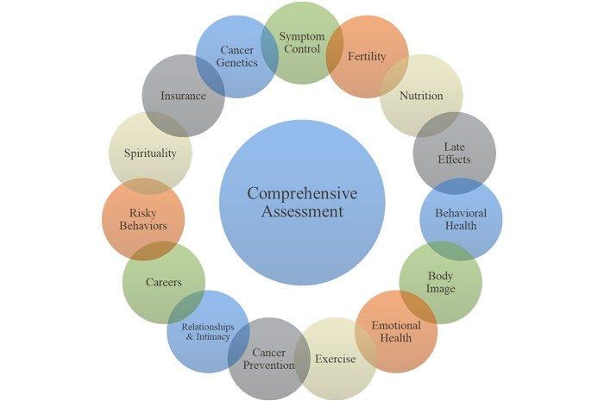
MD Anderson AYA Program
Notes:
As you can see, based on an understanding of the needs of the patients, the comprehensive approach to the patient care has built loyalty and patient retention equal to what great oncologic care can garner. This model took a non existent AYA program at MDA to the largest in the country in just a few years.

Slide 48
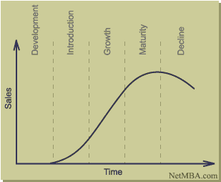
Business
Learning Objective:
4. Marketing Principles and Tools continued.
Product Life Cycle
Notes:
Products have a life cycle starting with development and ending with decline. Think about the iPhone. If you are holding the current model in your hand, unless you work for Apple, likely it is either at the maturity or decline phases of the product’s life cycle.

Slide 49
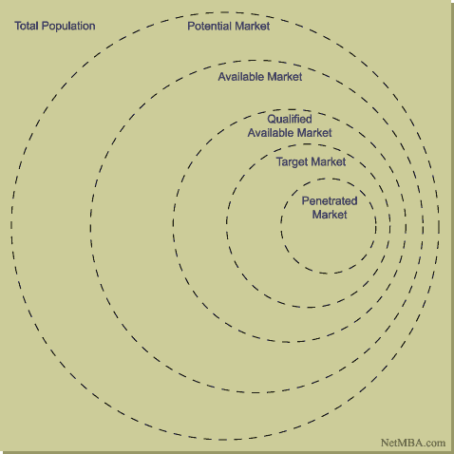
Business
Learning Objective:
4. Marketing Principles and Tools continued..
Market Definition
Notes:
What is the actual market? Need to define the intended market for service or product.
Example: Total population = all people, Potential market =sick people, Available market =people in geographical locality, Qualified available market =people who can pay for/have insurance to cover cost of care, Target market= specific types of health issues/desired services, Penetrated market =people served by hospital.

Slide 50
Business
Learning Objective:
4. Marketing Principles and Tools continued..
The Marketing Process
  Situation Analysis
  Marketing Strategy
  Marketing Mix Decisions
  Implementation and Control
Notes:
Like strategic planning, marketing has sequential steps to ensure success.

Slide 51
Business
Learning Objective:
4. Marketing Principles and Tools continued..
The Marketing Process-Situation Analysis
  Analysis of external/internal environment
  Should yield a summary of problems and opportunities
  Three traditional frameworks in analysis
    5Cs-Company, Customers, Competitors, Collaborators, Climate
    PEST-Political, Economic, Societal, Technological
    SWOT-Strengths, Opportunities, Weaknesses, Threats
Notes:
(See slide details)
5 Cs
PEST
SWOT

Slide 52
Business
Learning Objective:
4. Marketing Principles and Tools continued..
The Marketing Process-Marketing Strategy
  Segmentation: The identification of portions of the market that are different from one another. They should be identifiable, accessible, substantial, respond to unique needs, durable
    Consumer markets can be segmented into geographic, demographic, psychographic (lifestyle), behavioralistic (actual behavior towards products)
    Industrial markets can be segmented into characteristics such as location, company type, and behavioral
Notes:
Consumer market: goods purchased by individuals ex: books, clothing, groceries. Very broad market segmented by demographics or geography. For example, HEB doesn’t sell the same grocery products at every store- it customizes according to the local consumer market.
Industrial market: specialized products and services for select consumers. Example laundry services for hospitals.

Slide 53
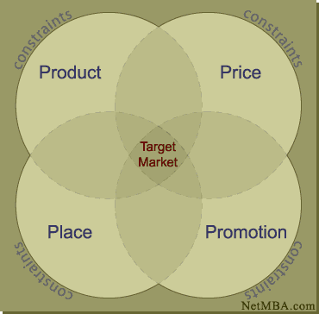
Business
Learning Objective:
4. Marketing Principles and Tools continued..
The Marketing Process-Marketing Mix Decisions
  Product
  Price
  Place
  Promotion
Notes:
EXAMPLE:
Product: deliver cardiovascular care.
Price: Charges are $X.
Place: Deliver care in Houston and the greater Houston area.
Promotion: “Leading medicine” tag line Methodist. “Making Cancer History” tag line – logo has a red strike out line through “Cancer”
Intersection of these 4 is the target market.

Slide 54
Business
Learning Objective:
4. Marketing Principles and Tools continued..
The Marketing Process-Implementation/Control
  Markets are not static, they are dynamic
  Adjust marketing mix to respond to changes
  Product redesign or new product may be needed
  Required to fulfill customer needs over the long term
Notes:
Health care technology, research outcomes, and advances change what the public wants and what hospitals need to provide in order to compete in the marketplace. Example: may have successful health care program including diagnostic colonoscopy services. Advances in research show that prevention at early ages helps yield better health outcomes. New product- prevention : screening colonoscopies including virtual colonoscopy or capsule endoscopy appeals to a broader market.

Slide 55
Business
Marketing Knowledge Quiz:
Which of the following is not an example of marketing function?
a. Promoting the organization
b. Convincing patients to select the organization
c. Managing external relationships
d. Reviewing organizational costs

Slide 56
Business
Marketing Knowledge Quiz:
Which of the following is not an example of marketing function?
a. Promoting the organization
b. Convincing patients to select the organization
c. Managing external relationships
d. Reviewing organizational costs
Notes:
D. Reviewing organizational costs. This may be a part of situational assessment that helps develop a marketing plan, but it is not a marketing function.

Slide 57
Business
Marketing Knowledge Quiz:
The volume that would be realized if each prospective consumer were to purchase a specified amount of a particular service during a defined future time frame is called:
a. A sales forecast.
b. A market forecast.
c. Operational capacity.
d. Market potential.

Slide 58
Business
Marketing Knowledge Quiz:
The volume that would be realized if each prospective consumer were to purchase a specified amount of a particular service during a defined future time frame is called:
a. A sales forecast.
b. A market forecast.
c. Operational capacity.
d. Market potential.
Notes:
D. Market potential. While determining capacity and forecasting may be part of situational analysis used to develop a marketing plan, it is not the goal of the plan- goal is to reach market potential.

Slide 59
Business
Marketing Knowledge Quiz:
Name the five major functions of marketing.
a. Identifying markets, promoting the organization, recruitment of providers, managing external relationships, patient selection.
b. Identifying markets, health promotion, managing external relationships, patient selection, attracting capable workers.
c. Identifying markets, promoting the organization, managing external relationship, convincing patients to select the organization, attracting capable workers.
d. Identifying markets, promoting the organization, managing external relationships, strategic planning, physician recruitment.

Slide 60
Business
Marketing Knowledge Quiz:
Name the five major functions of marketing.
a. Identifying markets, promoting the organization, recruitment of providers, managing external relationships, patient selection.
b. Identifying markets, health promotion, managing external relationships, patient selection, attracting capable workers.
c. Identifying markets, promoting the organization, managing external relationships, convincing patients to select the organization, attracting capable workers.
d. Identifying markets, promoting the organization, managing external relationships, strategic planning, physician recruitment.
Notes:
C is correct

Slide 61
Business
Learning Objective:
Public and Community Relations (e.g., the
community’s or public’s perception can be a major
factor in the survival of the healthcare organization;
any loss of support from the community will mean few
patients, volunteers and donor support; to enhance
public image, Chyna identifies several strategies: (1)
focus on personal interaction (improving the day-to-
day interactions between patients and caregivers),
Notes:
Healthcare organizations and healthcare professionals are trusted by the public, which carries a great deal of responsibility.
To survive and thrive the organization must be trusted by the community.
One strategy: Patient experience is tied closely to reputation in the public’s eye- think Facebook, Twitter, Healthgrades, Yelp, Tic Toc, Linked-In, Beckers Review, etc.

Slide 62
Business
Learning Objective:
Public and Community Relations continued…. (2)
enhance employee morale (paying attention to job
satisfaction issues so that employees have a positive attitude
about their jobs that, in turn, is conveyed to patients), (3)
connect with the community (e.g., conducting health education
programs at community sites, having a dedicated hotline for
patients to express their concerns and holding public forums
where community members can interact with organization
leaders and (4) work with the media (e.g., sending out regular
news releases and newsletters, or having members of the
media sit on advisory panels)
Notes:
Other strategies:
Employee morale: Day to day interactions between patients and caregivers- depends on EEs having positive attitudes about their jobs.
Connection with community: Responsibility to promote health in the community- health fairs, flu shot clinics, etc. Interviews on radio and other talk shows- example: Childhood cancer awareness facts.
Advisory Councils that include patients, families, and others, interact with leadership on how to improve.
Proactively work with media – press releases, interviews, provide expertise, etc.
Public Relations professionals- interact with media.

Slide 63
Business
Learning Objective:
Public and Community Relations continued….
  Personal Interaction
    Develop a service excellence program which motivates employees to communicate a shared message to patients and families
      Constantly disseminate mission and values
      Walk the talk with employees: we value your efforts and value your opinions
    Employees who are treated well by their employers as both patients and employees can be an organizations strongest advocate. Pay attention to compensation and feedback
Notes:
Employee opinion surveys, focus groups, advisory councils to leadership promote employee satisfaction- all employees are ambassadors of the organization.
When people see me in the grocery store with my hospital’s logo t-shirt, they want to tell me their stories about positive experiences they, their friends, or families have had.

Slide 64
Business
Learning Objective:
Public and Community Relations continued….
  Connect with the community
    Provide descriptive information and promote personal appearances by management and caregivers
    Interact with influential community leaders
    Highlight newsletters, annual reports, web sites, new releases and regular mailings. Advertise national ratings on outcomes, outstanding programs
    Assure your name and mission in branded in the minds of the community - Leading Medicine (Methodist Hospital), Making Cancer History (MD Anderson)
Notes:
Important to be visible in the local community. Many options for this.

Slide 65
Business
Learning Objective:
Public and Community Relations continued….
  Connect with the community
    Issue planned releases for media consideration
    Respond to media inquiries in an anticipatory and honest fashion
    Encourage wellness and disease prevention
    Make your case for selecting your institution over others
    Adjust patient expectations to the reality of the market, such as using less acute providers and care when appropriate. Educate the public!

Slide 66
Business
Learning Objective:
Organizational Policies and Procedures (e.g., policies
and procedures that provide ongoing guidance for members
of the organization; policies are two types: general (applies to
the entire organization) and operational (pertains to a specific
unit, department or service); procedures are used to define
specific actions for organizational members)
Notes:
Tell the story - “We need a policy” - do we really need another one?
General: every member of the workforce must have a background check prior to starting employment.
Operational: a time out procedure is completed at the start of every surgical procedure.

Slide 67
Business
Learning Objective:
Organizational Policies and Procedures continued….
  A set of documents that describe an organization’s policies for operation and the procedures necessary to fulfill the policies
  Necessary to comply with external requirements or to define internal systems
Notes:
Ensures regulatory compliance with governmental agencies. Ensures process consistency in alignment with agreed standards for internal systems.

Slide 68
Business
Learning Objective:
Organizational Policies and Procedures continued….
  Keys to compliance
    Standard Format
      Purpose, persons affected, scope, background section, a policy section, definitions, responsibilities, and a procedures section
    Hiring/developing technical writing staff
    Solicit end user input
Notes:
Standardized format helps ensure compliance. Details are key here- every employee reading a policy must be able to understand and comply with it.
Routine schedule of policy review is required to ensure relevance, accuracy, and compliance with external requirements.

Slide 69
Business
Learning Objective:
Organizational Policies and Procedures continued….
  Keys to compliance
    Assure proper training and follow-up auditing
    Combine policy with the associated procedures on the same document
Notes:
Decide what type and depth of training is needed for which policies.
For example, a Conflict-of-Interest policy can be somewhat confusing and should probably have instructor led training. Proper use of face masks and other PPE can be done with a computer-based training.
Some policies may have guidance documents attached- this allows the guidance to be updated without a formal policy review/update.

Slide 70
Business
Learning Objective:
Organizational Policies and Procedures continued….
    The Seven “C’s”
      Context-properly describe activity
      Consistency
      Completeness-no info, logic, design gaps
      Control-describes feedback and control
      Clarity-easy to read
      Correctness-no spelling errors/well written
      Compliance-actions fulfill goals
Notes:
Comprehensive checklist to stand policies up against – the 7 Cs. Every policy should contain the 7 Cs.

Slide 71

Business
Any questions?

